Slide 1

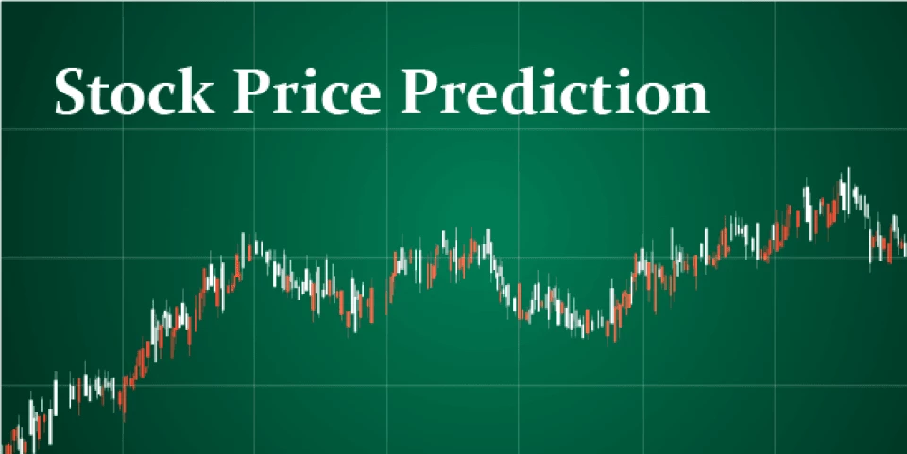
STOCK PRICE PREDICTION

Slide 2

PANCHAGIRI VIDYASRI
2203A52116
AIML_A

Slide 3
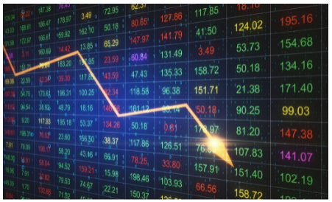

What is the Stock Market?
A stock market is a public market where you can buy and sell shares for publicly listed companies. The stocks, also known as equities, represent ownership in the company. The stock exchange is the mediator that allows the buying and selling of shares.

Slide 4
Importance of Stock Market
Stock markets help companies to raise capital.
It helps generate personal wealth.
Stock markets serve as an indicator of the state of the economy.
It is a widely used source for people to invest money in companies with high growth potential.

Slide 5
Stock Price Prediction
Stock Price Prediction using machine learning helps you discover the future value of company stock and other financial assets traded on an exchange. The entire idea of predicting stock prices is to gain significant profits. Predicting how the stock market will perform is a hard task to do. There are other factors involved in the prediction, such as physical and psychological factors, rational and irrational behavior, and so on. All these factors combine to make share prices dynamic and volatile. This makes it very difficult to predict stock prices with high accuracy.

Slide 6

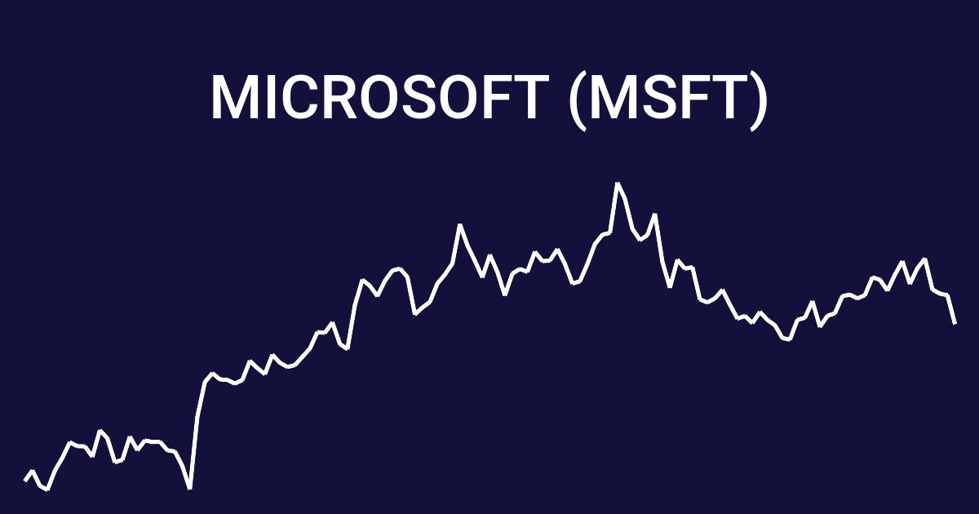
Given historical stock price data for Apple, Microsoft, Netflix and Google over the past three months, your task is to analyze and compare the performance of these companies in the stock market using various data science techniques.

Slide 7


Specifically, the goal is to identify trends and patterns in stock price movements, calculate moving averages and volatility for each company, and conduct correlation analysis to examine the relationships between different stock prices.

Slide 8
The dataset you've provided appears to be historical stock price data for three companies (AAPL, MSFT, NFLX,GOOG) over a period of time. The columns include the Ticker (company name), Date, Open, High, Low, Close, Adjusted Close, and Volume. This dataset contains numerical and time-series data, making it suitable for various types of analysis, including regression. Data Structure The date for every symbol is saved in CSV format with common fields: Date - specifies trading date Open - opening price High - maximum price during the day Low - minimum price during the day Close - close price adjusted for splits Adj Close - adjusted close price adjusted for both dividends and splits. Volume -the number of shares that changed hands during a given day

Slide 9
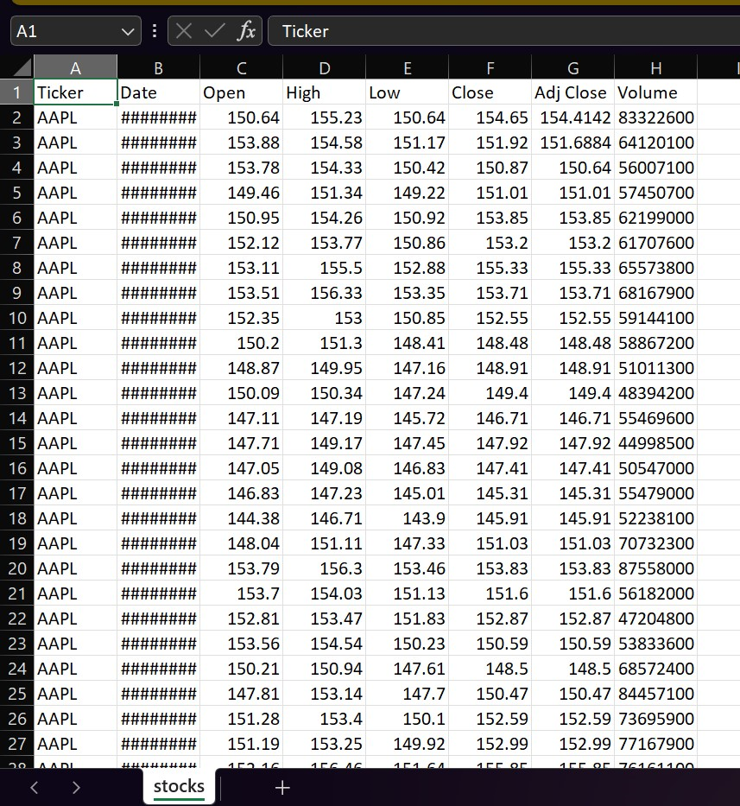
This is my dataset in my dataset there are [248 rows x 8 columns]

Slide 10

MACHINE LEARNING MODELS:
THE MACHINE LEARNING MODELS USED IN THIS PROJECT ARE:
1)LINEAR REGRESSION
2)SUPPORT VECTOR MACHINE(SVM)

Slide 11
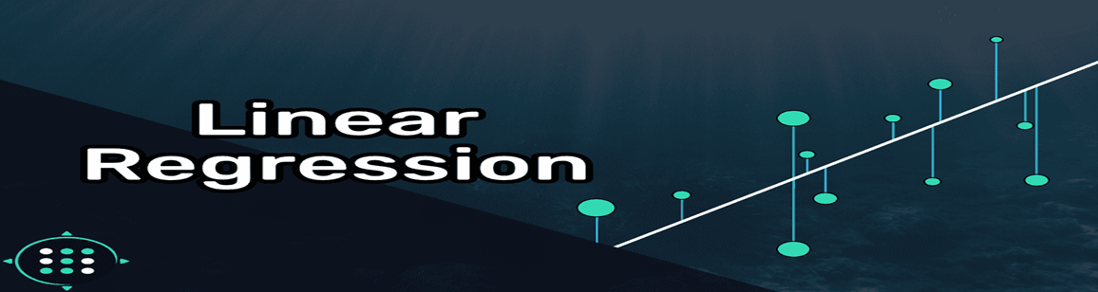
Linear Regression:
Linear regression is used for predicting a continuous outcome variable (dependent variable) based on one or more predictor variables (independent variables). In this dataset, you might consider using linear regression if you want to predict a continuous variable, such as the closing price of a stock (e.g., Close or Adjusted Close), based on one or more of the other variables (e.g., Open, High, Low, Volume) and potentially the Date as a time-based feature.

Slide 12
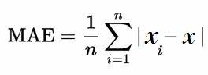
Mean Absolute Error (MAE):
Use Case: MAE is used to measure the average
absolute errors between predicted values andactual (observed) values.
Interpretation: It gives you a sense of the
magnitude of errors without considering their direction.
Robustness: MAE is less sensitive to outliers
comparedto RMSE, making it a good choice when your
dataset contains extreme values or anomalies.
Mathematical Form: MAE = (1/n) * Σ|actual - predicted|, where n is the number of data points.

Slide 13
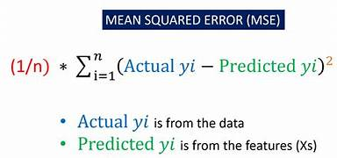
Mean Squared Error (MSE):
Use Case: MSE is used to measure the average of the
squared differences between predicted values and actual values.
Interpretation: It emphasizes larger errors more than
smaller ones due to the squaring operation.
This makes it sensitiveto
outliers.
Mathematical Form: MSE = (1/n) * Σ(actual - predicted)²,
where n is the number of data points.
Advantage: MSE is mathematically convenient for
optimization algorithms because it results in
smoother gradients.

Slide 14
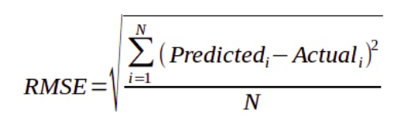
Root Mean Squared Error (RMSE):
Use Case: RMSE is a variant of MSE. It is often preferred when you want to report errors in the same units as the dependent variable.
Interpretation: RMSE is the square root of MSE, which means it provides a measure of error in the same units as the dependent variable. This makes it more interpretable.
Mathematical Form: RMSE = √(MSE).
Advantage: RMSE is helpful when you need to communicate the error magnitude in a more easily understandable way.

Slide 15
Support Vector Machine
->SVM stands for Support Vector Machine, which is a machine learning algorithm used for classification and regression tasks. It is a supervised learning algorithm, meaning it requires labeled training data to make predictions.
The primary goal of an SVM is to find a hyperplane that best separates data points belonging to different classes in a way that maximizes the margin between the classes. The margin is defined as the distance between the hyperplane and the nearest data points from each class. These nearest data points are called support vectors, hence the name "Support Vector Machine."
->Both linear and nonlinear classification tasks. In the case of linearly separable data, a linear hyperplane is used to separate the classes. When the data is not linearly separable, SVMs can still handle the task by mapping the data into a higher-dimensional space using a technique called the kernel trick. This allows SVMs to find a hyperplane in the transformed space that can separate the data. ->SVMs can handle

Slide 16
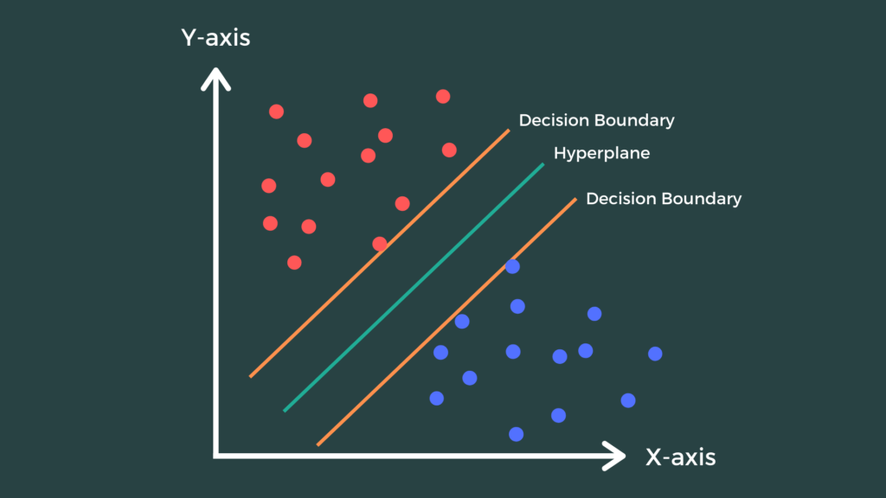
Key features of SVMs include:
Maximum Margin: SVMs aim to find the hyperplane that maximizes the margin between classes, which often results in good generalization to unseen data.
Support Vectors: The support vectors are the data points closest to the decision boundary and are critical in determining the hyperplane. These support vectors are used to calculate the margin.
Kernel Trick: SVMs can handle nonlinear data by transforming it into a higher-dimensional space using kernel functions. Common kernels include linear, polynomial, radial basis function (RBF), and sigmoid kernels.
Regularization: SVMs can incorporate regularization parameters to control the trade-off between maximizing the margin and minimizing classification errors on the training data.

Slide 17
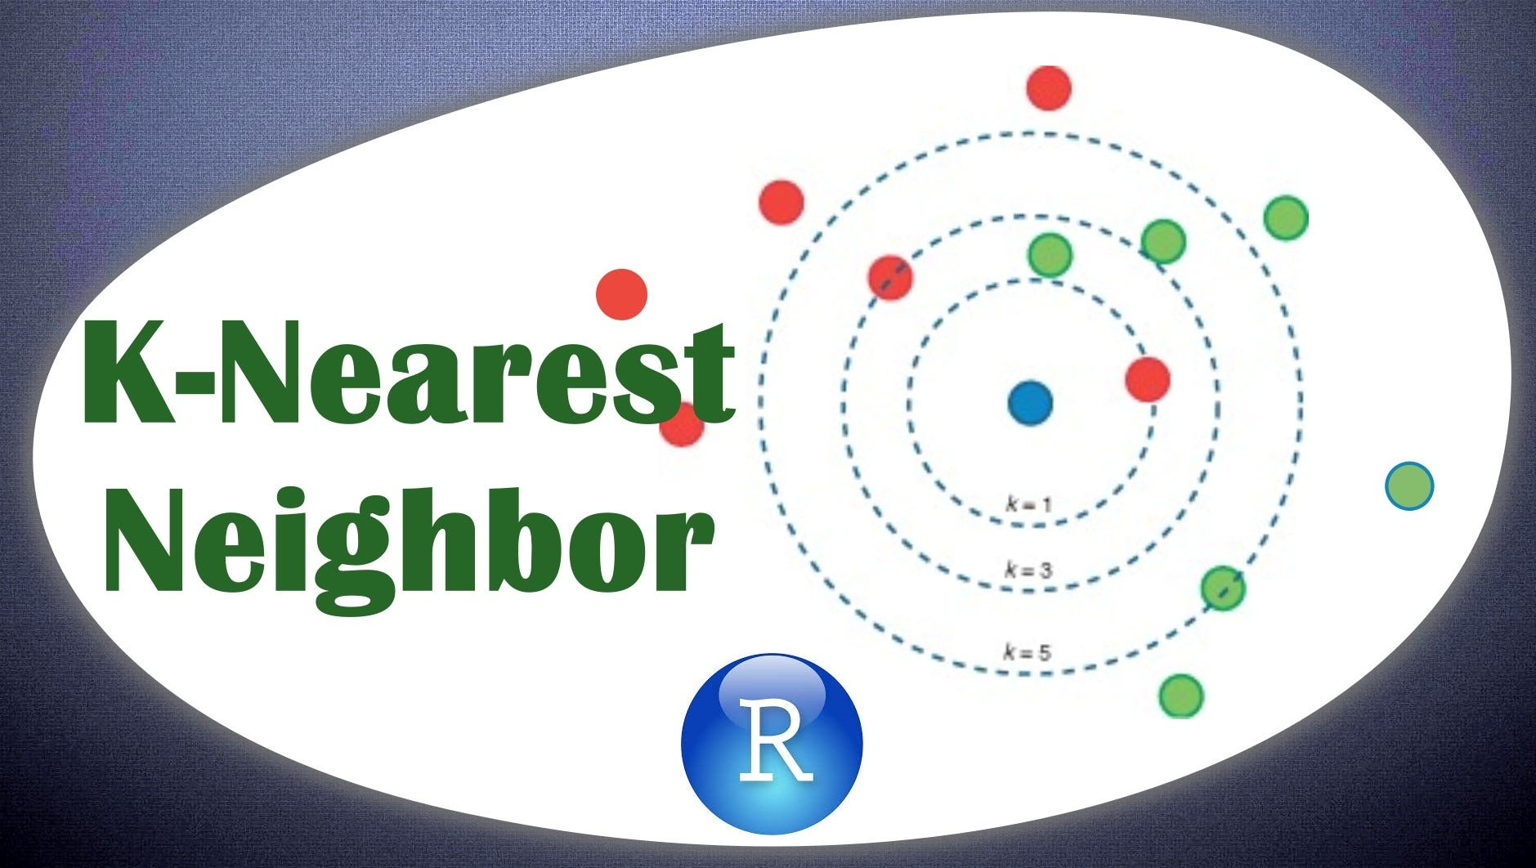
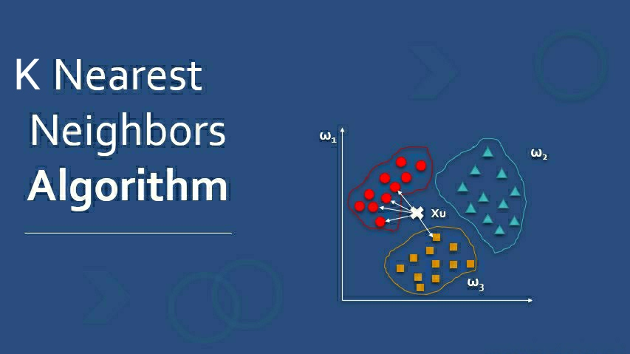
K-Nearest Neighbors (KNN) is a simple and intuitive machine learning algorithm used for classification and regression tasks. It's based on the idea that objects or data points that are close to each other in a feature space tend to have similar characteristics or outcomes. KNN can be used for both supervised and unsupervised learning, but it's most commonly associated with supervised classification problems.

Slide 18
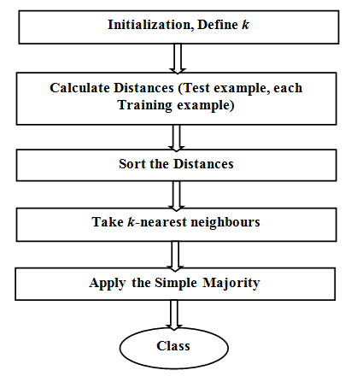
Here's an explanation of how KNN works:
Training Phase:During the training phase, the algorithm simply stores the entire training dataset, which consists of labeled data points. Each data point has a set of features and is associated with a specific class label in the case of classification or a target value in the case of regression.
2.Testing or Prediction Phase:
When you want to make a prediction for a new, unlabeled data point, KNN works as follows:
Calculate the distance between the new data point and all the data points in the training dataset. The distance metric used is typically Euclidean distance, but other distance measures like Manhattan or Minkowski can also be used.

Slide 19
Select the top 'K' data points from the training set that are closest to the new data point based on the calculated distances. 'K' is a user-defined parameter that you need to specify before applying the algorithm.
For classification tasks, count the number of data points in each class among the 'K' nearest neighbors.
For regression tasks, calculate the average or weighted average of the target values from the 'K' nearest neighbors.
3.Decision Making:
For classification, the class label for the new data point is determined by a majority vote among its 'K' nearest neighbors. The class with the most occurrences among the 'K' neighbors is assigned as the predicted class.
For regression, the predicted value is typically the mean (for simple KNN) or a weighted mean (for weighted KNN) of the target values of the 'K' nearest neighbors.

Slide 20
when using KNN:
The choice of the parameter 'K' is critical. A smaller 'K' makes the algorithm more sensitive to noise in the data, while a larger 'K' can smooth out the decision boundaries but might make the algorithm less discriminative.
Feature scaling is often necessary because KNN is sensitive to the scale of the features.
KNN can be computationally expensive when dealing with large datasets because it requires calculating distances between the new data point and all training data points.
It's important to choose an appropriate distance metric based on the characteristics of your data.
KNN is a non-parametric algorithm, which means it doesn't make assumptions about the underlying data distribution.

Slide 21
LASSO REGRESSION:
Lasso regression, short for "Least Absolute Shrinkage and Selection Operator" regression, is a linear regression technique used for feature selection and regularization. It is a modification of ordinary least squares (OLS) regression and is particularly useful when dealing with datasets that have a large number of features or predictors. Lasso regression helps prevent overfitting and simplifies the model by encouraging some of the regression coefficients to be exactly zero.
The primary characteristic of lasso regression is its regularization term, which adds a penalty to the OLS cost function. The cost function in lasso regression is given by:
Cost = OLS Cost Function + λ * Σ|βi|
Where:

Slide 22
>OLS Cost Function: This is the ordinary least squares cost function, which minimizes the sum of squared differences between the predicted values and the actual target values.
λ (lambda): This is the regularization parameter, which controls the strength of regularization. A higher λ value leads to stronger regularization.
Σ|βi|: This term represents the sum of the absolute values of the regression coefficients (βi).
The lasso regularization term encourages the coefficients (βi) of some features to be exactly zero, effectively eliminating those features from the model. This feature selection property of lasso makes it a valuable tool when dealing with high-dimensional datasets or when you suspect that only a subset of features is relevant for predicting the target variable.
Lasso regression is especially useful in situations where you want to strike a balance between model complexity and accuracy. It can help you build simpler and more interpretable models while still retaining predictive power. The choice of the regularization parameter (λ) is crucial, as it determines the extent of regularization and feature selection.

Slide 23
RIDGE REGRESSION:
The key characteristic of ridge regression is the addition of a regularization term, often represented as L2 regularization, to the ordinary least squares (OLS) cost function. The cost function in ridge regression is given by:
Cost = OLS Cost Function + λ * Σ(βi^2)
Where:
OLS Cost Function: This is the ordinary least squares cost function, which minimizes the sum of squared differences between the predicted values and the actual target values.
λ (lambda): This is the regularization parameter, which controls the strength of regularization. A higher λ value leads to stronger regularization.
Σ(βi^2): This term represents the sum of the squared values of the regression coefficients (βi).

Slide 24
The ridge regularization term encourages the regression coefficients to be small, but it doesn't force them to be exactly zero. This means that all features are included in the model, but their contribution to the prediction is moderated. The result is that ridge regression tends to shrink the coefficient estimates towards zero, which can help mitigate multicollinearity issues and reduce overfitting in the model.
Ridge regression is particularly useful when dealing with datasets with a high degree of multicollinearity, as it allows you to include all the features in the model while preventing excessively large coefficient values. Like lasso regression, the choice of the regularization parameter (λ) is important, and cross-validation can be used to determine the optimal value of λ for a given dataset.

Slide 25
Bootstrapping
Bootstrapping is a resampling technique that helps in estimating the uncertainty of a statistical model.
It includes sampling the original dataset with replacement and generating multiple new datasets of the same size as the original.
Each of these new datasets is then used to calculate the desired statistic, such as the mean or standard deviation.
This process is repeated multiple times, and the resulting values are used to construct a probability distribution for the desired statistic.
This technique is often used in machine learning to estimate the accuracy of a model, validate its performance, and identify areas that need improvement.
Here are the basic steps for performing a bootstrap analysis:
Original Dataset: Start with your original dataset, which is a sample from a population or a dataset you want to analyze.
Resampling: Randomly select data points from the original dataset with replacement to create multiple bootstrap samples. Each bootstrap sample is typically the same size as the original dataset.

Slide 26
3.Calculate Statistic: For each bootstrap sample, calculate the statistic of interest. This can be a mean, median, standard deviation, regression coefficient, or any other parameter you want to estimate.
4.Repeat: Repeat steps 2 and 3 a large number of times (e.g., 1,000 or 10,000 times) to create a distribution of the statistic you are interested in. This distribution is an approximation of the sampling distribution of that statistic.
5.Analyze the Bootstrap Distribution: With the distribution of the statistic obtained from the bootstrapped samples, you can calculate confidence intervals, assess bias, variance, or perform hypothesis tests.
Bootstrapping is particularly useful when you have a limited amount of data or when the assumptions underlying traditional statistical methods are not met. It allows you to make inferences and perform statistical analyses without relying on complex mathematical distributions or assumptions about the underlying data.

Slide 27
Bootstrap for Lasso & Ridge Regression
1.It defines the number of bootstrap samples to be 100 for resampling.
2.The code initializes empty lists to store MSE values for Lasso and Ridge regression.
In a loop, it performs bootstrap resampling:
3.Randomly selects training data with replacement (bootstrapping).
>Fits Lasso and Ridge regression models on the bootstrap sample.
>Makes predictions on the testing set and calculates the MSE for each model.
>Appends the MSE values to corresponding lists.
4.It prints the MSE values for the last bootstrap sample, though it would be more informative to print summary statistics for all samples.
5.The code creates histograms of MSE values for both Lasso and Ridge regression models.
Titles and labels are added to the subplots for clarity.
6.The histograms are displayed side by side using plt.show().

Slide 28
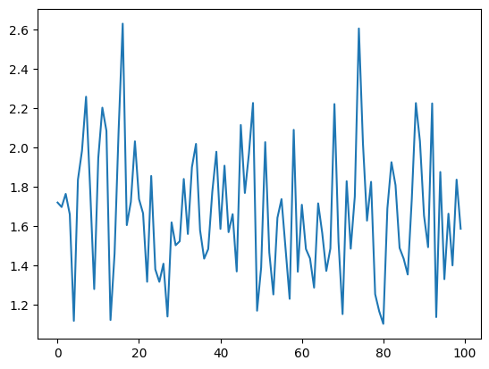
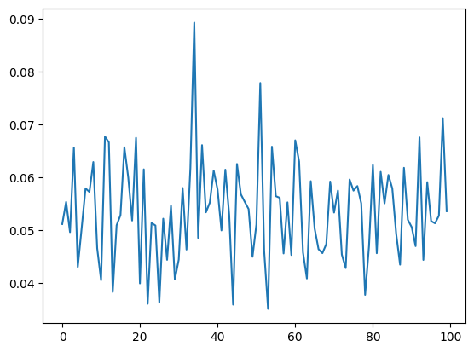
The code iterates through MSE values and prints them for each bootstrap sample, though there's an error in the variable name, and it should be lasso_mse_values and ridge_mse_values to print the correct values

Slide 29
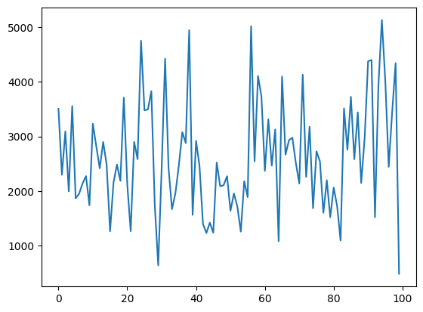
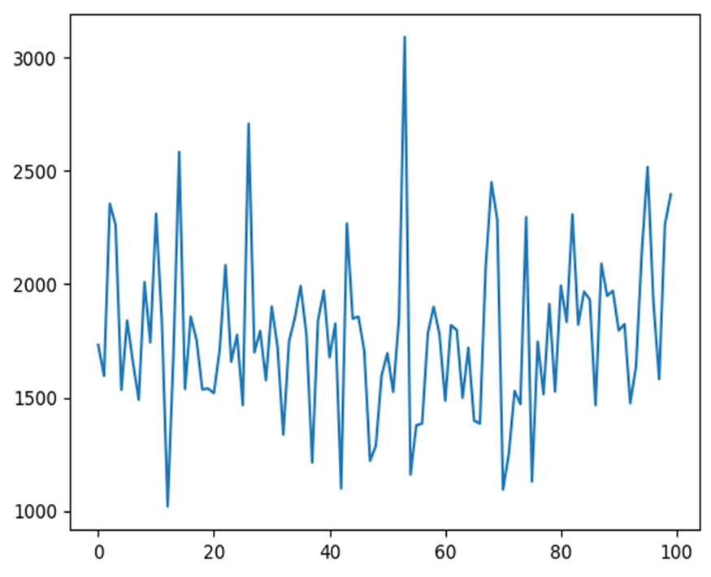
Bootstrap for KNN Regression
Bootstrap for Linear Regression

Slide 30
comparition:
By comparing my model with some of the model in Kaggle and google I found the they just read the data from dataset and did up to mse,mape ,mae only.
but I have done mse,mae,rmse,svm,knn,linear regression,lasso,ridge and bootstrap
There my results:
Linear regression using bootstrap:
Average Mean Squared Error (MSE): 1821.4641554843747
Average Coefficients: [ 25.16894544 -4.89148866 -6.55211314 -12.87306101
-12.217967 ].
Lasso and ridge using bootstrap:
lasso_mse: 1.429474182245677 ridge_mse: 0.04354676344524589
Lasso and ridge:
Lasso Regression MSE: 1.5766623872000551 Ridge Regression MSE: 0.051955943033180636
Knn:
Mean Squared Error (MSE): 6860177456184.0

Slide 31
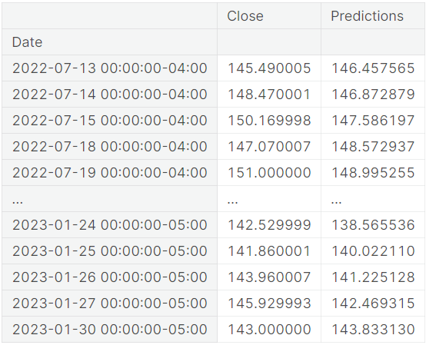
FARES SAYAH

Slide 32
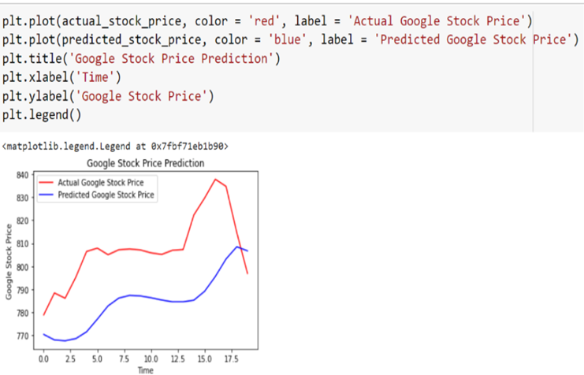
Avijeet Biswal

Slide 33
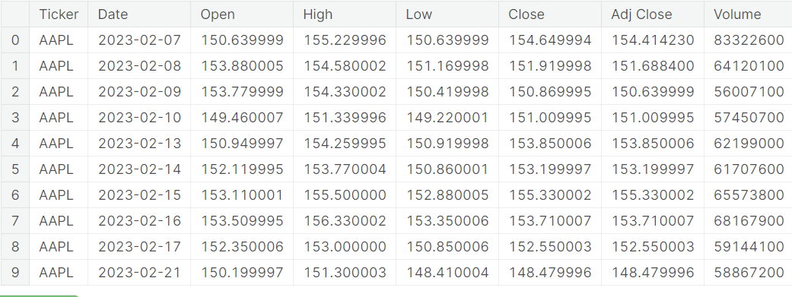
ABHISHEK BAGWAN

Slide 34
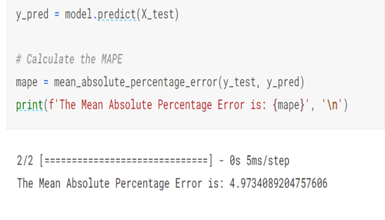
ASHIOYAJOTHAM

Slide 35
Conclusion
Stock Market Performance Analysis involves calculating moving averages, measuring volatility, conducting correlation analysis, and analyzing various aspects of the stock market to gain a deeper understanding of the factors that affect stock prices and the relationships between the stock prices of different companies.
By doing there all methods I came to conclude that lasso regression and ridge regression using bootstrap is best fit model for my project

Slide 36
There are the results of lasso regression and ridge regression using bootstrap method
Lasso mse: 1.429474182245677
Ridge mse: 0.04354676344524589

Slide 37
This is the explanation that what I did in my project code(Conclusion of code).
1.Reading Data:
It imports the pandas library and reads a CSV file located at "/content/stock(stml).zip" into a DataFrame 'a’.
2.Data Preprocessing:
It seems to be trying to replace values in the 'Ticker' column with numerical values (0, 1, 2, or 3) based on specific mappings. However, there's an issue with the placement of this code snippet, as it should be after reading the data.
3.Data Visualization:
It uses matplotlib to create histograms for each column in the 'data' DataFrame. The histograms show the distribution of data in each column.

Slide 38
4.Machine Learning:
It splits the data into training and testing sets.
It initializes a Linear Regression model and fits it to the training data, then makes predictions on the test data.
It calculates and prints various regression metrics such as Mean Absolute Error (MAE), Mean Squared Error (MSE), Root Mean Squared Error (RMSE), and for the linear regression model.
It also initializes a Support Vector Regressor (SVR) model with some hyperparameters but doesn't use the ‘x_train' and 'y_train' variables that are undefined.
It imports necessary libraries for machine learning from scikitlearn.

Slide 39
5.Data Scaling:
It attempts to scale the 'x' data using MinMaxScaler.
6.More Machine Learning:
It splits the scaled data into training and testing sets.
It initializes another Linear Regression model and fits it to the training data.
It makes predictions using the SVM classifier and calculates regression metrics (MAE, MSE, RMSE) for this model.

Slide 40
K-Nearest Neighbors (KNN) Regression
1.Import necessary libraries: The code begins by importing the required Python libraries, such as NumPy, scikit-learn (a machine learning library), and Matplotlib (for data visualization).
2.Splitting the data: It uses scikit-learn's train_test_split function to split the data into training and testing sets (X_train, X_test, y_train, y_test). The data appears to be loaded from previously defined features and target variables.
3.KNN Regression: It creates a KNN regression model with 5 neighbors (n_neighbors=5) and fits this model to the training data.
4.Calculate Mean Squared Error (MSE): It then uses the KNN model to make predictions on the test data and calculates the mean squared error (MSE) between the predicted values and the actual target values.

Slide 41
5.Loop for different K values: The code then enters a loop where it iterates through different values of K for KNN, from 1 to 20. For each K value, it trains a new KNN model, predicts on the test data, and calculates the MSE. The MSE values for different K values are stored in the mse_values list.
6.Plotting: Finally, it uses Matplotlib to create a plot that shows how the MSE changes with different values of K for the KNN model.
Lasso and Ridge Regression
1.Lasso and Ridge Regression: The code starts by generating synthetic data using make_regression and then splits it into training and testing sets using train_test_split.
2.Lasso and Ridge regression models are created with an alpha value of 1.0 for each. They are fitted to the training data, and predictions are made on the test data.
3.MSE Calculation: The mean squared error (MSE) is calculated for both the Lasso and Ridge regression models.

Slide 42
4.Bootstrapping: The code enters a loop for bootstrapping. In each iteration, it randomly selects a subset of the training data with replacement, fits Lasso and Ridge regression models to the bootstrap sample, makes predictions on the test data, and calculates the MSE. The MSE values for both Lasso and Ridge are collected in the lasso_mse_values and ridge_mse_values lists, respectively.
5.Plotting (commented out): The code contains commented-out lines for plotting histograms of the bootstrapped MSE values for Lasso and Ridge regression. However, these lines are not executed in the code provided.
KNN Regression with Bootstrap
KNN Regression with Bootstrap: The code starts by importing the required libraries again. It then splits the data into training and testing sets, similar to the first KNN section.
Bootstrap for KNN: It enters a loop for bootstrapping (100 iterations). In each iteration, it randomly selects a bootstrap sample from the training data, fits a KNN regression model to this sample with 5 neighbors, predicts on the test data, and calculates the MSE. The MSE values for each iteration are stored in the mse_values list.
Plotting: The code creates a plot to show how the MSE values change across the 100 iterations for KNN with bootstrapping.

Slide 43
Linear Regression with Bootstrap:
Linear Regression with Bootstrap: This section is very similar to the KNN with Bootstrap section, but it uses a Linear Regression model instead. It bootstraps the training data, fits Linear Regression models to the bootstrap samples, predicts on the test data, and calculates the MSE in each iteration.
Plotting: The code creates a plot to show how the MSE values change across the 100 iterations for Linear Regression with bootstrapping.
Ridge Regression with Bootstrap:
Ridge Regression with Bootstrap: Similar to the previous sections, it bootstraps the training data and fits Ridge Regression models to the bootstrap samples. It then calculates the MSE in each iteration.
Plotting: The code creates a plot to show how the MSE values change across the 100 iterations for Ridge Regression with bootstrapping.

Slide 44
GitHub.lnk
https://github.com/Panchagiri-vidyasri/capston-project_stml

Slide 45
GitHub.lnk
https://github.com/Panchagiri-vidyasri/capston-project_stml/blob/main/project%20(2).ipynb

Slide 46


